Slide 1

Fork The Road
Team - Bootstrasm

Slide 2


WHAT IS FORK The ROAD?
BY: SHAWN SINGH, Brian Martinez, Wojciech Pierscionek,
& Adam Sawyer

Slide 3
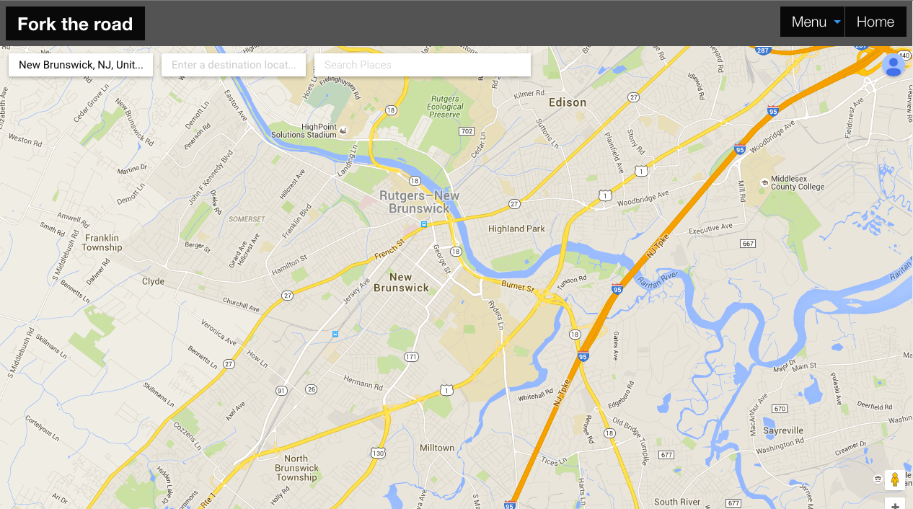
What is Fork the Road?
Fork the Road is an interactive application that allows the user the get directions for planning a road trip
Fork The RoAd - Team BOOTStrasm

Slide 4
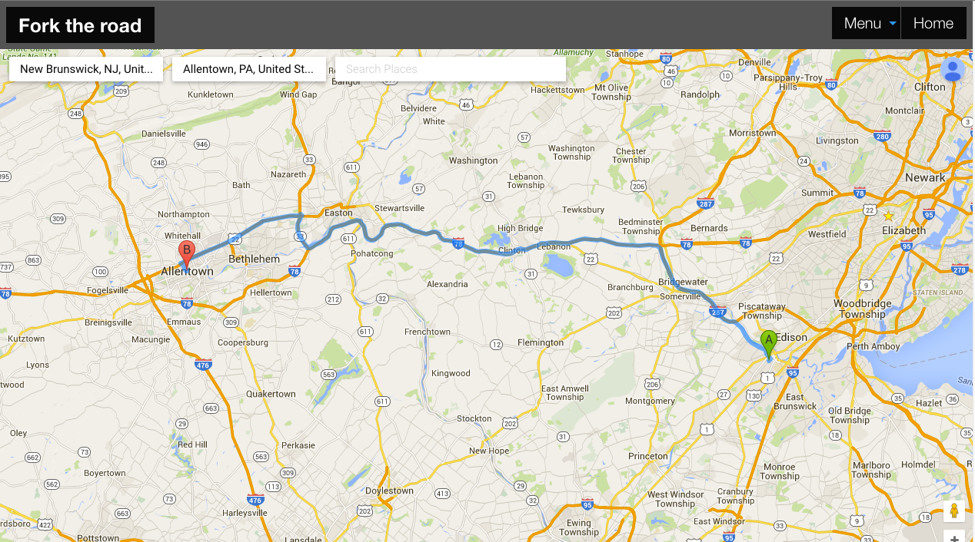
fork the road
team bootstrasm

Slide 5

Motivation
Fork The RoAd - Team BOOTStrasm
Simplicity - We wanted to create a simplified way to get directions and and plan for a road trip.
Relevance - We wanted to create a application that would be used in the real world
Fun - We wanted the application to be easy enough to use, so the focus is on what a road trip is all about…FUN.
It is universal enough in application for more uses than fun.

Slide 6
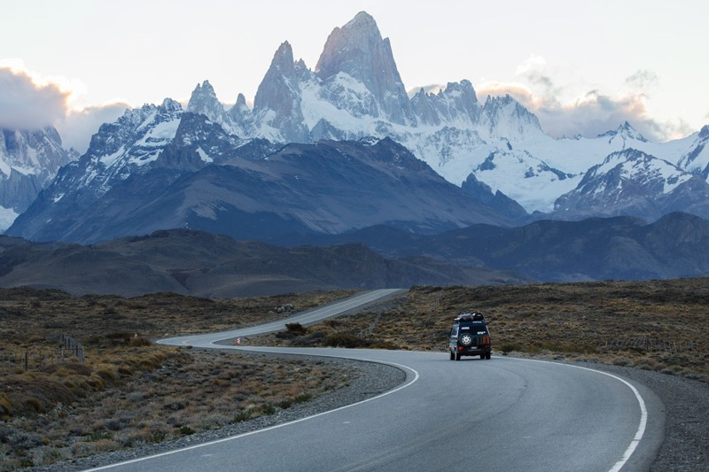
Design Process
Fork The RoAd - Team BOOTStrasm
We thought mapped out how we wanted to User interface to be.
So we set up three easy steps to run the the . Main Page, Optional Register Page, and then the Directions Page

Slide 7

Technologies Used
Fork The RoAd - Team BOOTStrasm
Used Google Maps, Places API. These API’s work together to plot the directions for a user, and to indicate the surrounding places (eg. Hotels, restaurants, etc)
Used Firebase server to remotely stores the users’ profile if they decide to sign up for the application.

Slide 8
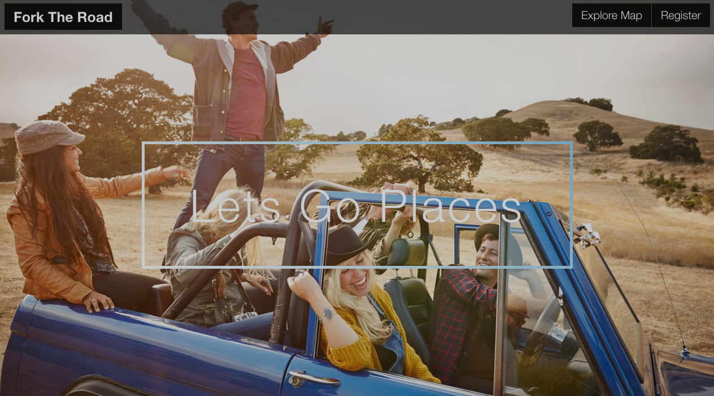
A Simple Demonstration
http://forktheroad.herokuapp.com/
Fork The RoAd - Team BOOTStrasm

Slide 9

What’s in The Future For Fork The Road
Fork The RoAd - Team BOOTStrasm
Enhance it so the user has the option to let the computer decide the best locations to eat, sleep, and visit along a given route.
Include Biking trails, hiking trails, and canoeing routes for the more adventurous
Include

Slide 10

any Questions?

Slide 11
Fork The Road
Team - Bootstrasm
The END

